Slide 1
Java Class
Day 2

Slide 2





Jul
Aug
Big Data Analyst(10/1)
ADsP(8.28) 8/1~8/5
8/29~9/2
TOEIC(7/24) 6/6~7/11
TOEIC(8/07) 6/20~7/25
TEPS(7/16) 6/29~7/12
TEPS (8/06) 6/20~7/17
TOEIC(8/21) 7/ 4 ~ 8/ 8
TEPS (8/20) 7/ 4 ~7/31
www.toeic.co.kr
www.teps.or.kr
www.dataq.or.kr
austin.sogang.ac.kr
austiny.snu.ac.kr

Slide 3
Mon
Tue
Wed
Thu
1. Main
2. Main
3. Main
4. Main
LUNCH
5. Sub
6. Sub
7. Sub
8. Recap, Test
Fri
1. Recap Sub
2.
3.
4.
LUNCH
5. Recap Main
6.
7.
8. Test
Jul
Java Basic
Aug
Java Intermediate
Database
HTML, CSS, JS

Slide 4
Java
4 Data Type & Operator
4.1 Data Type
4.1.1 Basic - Logical, Character, Integer, Double
4.1.2 Advance - Casting
4.2 Operator
4.2.1 Basic – Operators
4.2.2 Advance - Assignment / Arithmetic / Comparison / Logical
4.3 Exam
5 Control Statement
5.1 If
5.1.1 Basic - If ~ Else
5.1.2 Advance - Continue, Break
5.2 Switch
5.2.1 Basic
5.2.2 Advance
5.3 Exam

Slide 5


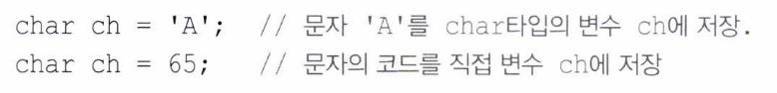
4 Data Type & Operator 4.1 Data Type

Slide 6
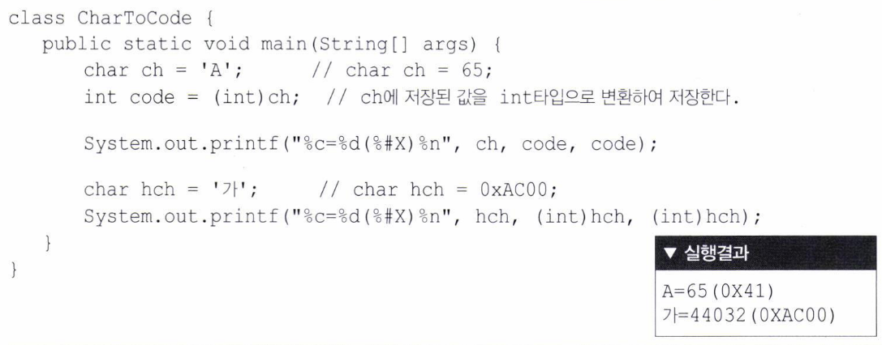

Slide 7

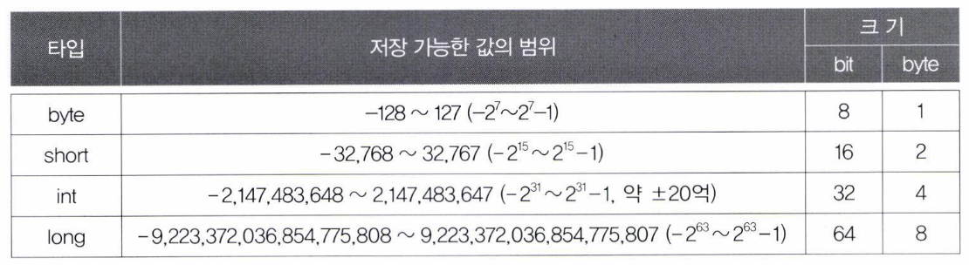

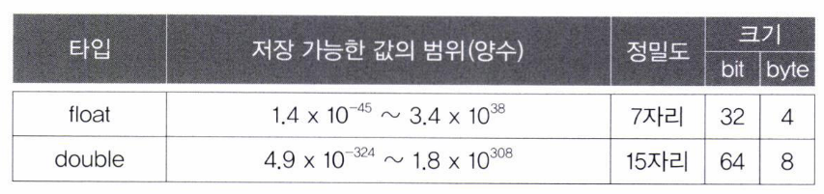

Slide 8
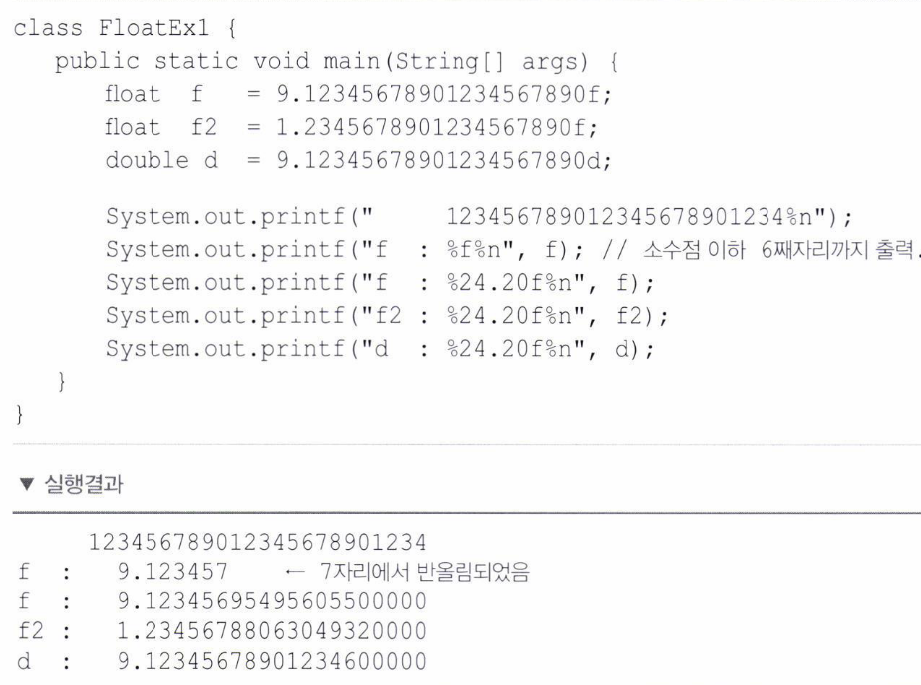

Slide 9

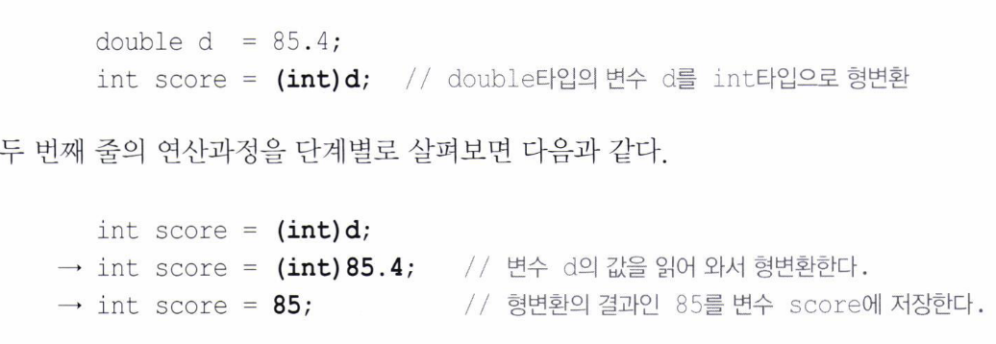

Slide 10
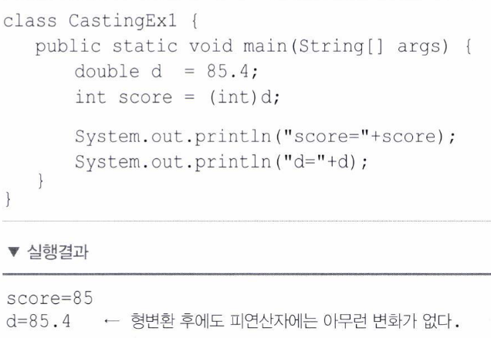

Slide 11
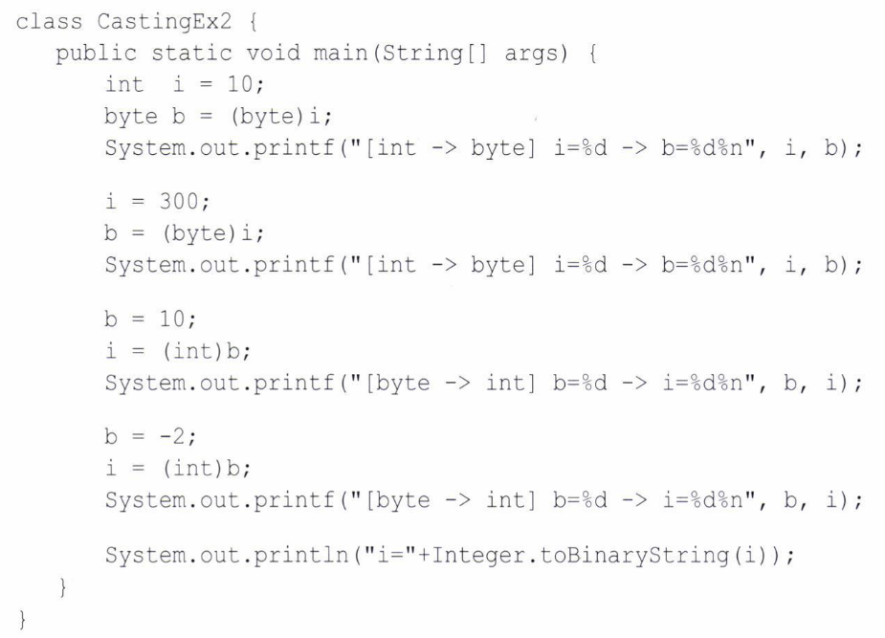
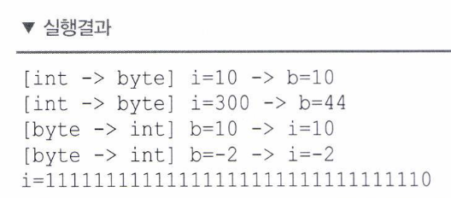

Slide 12
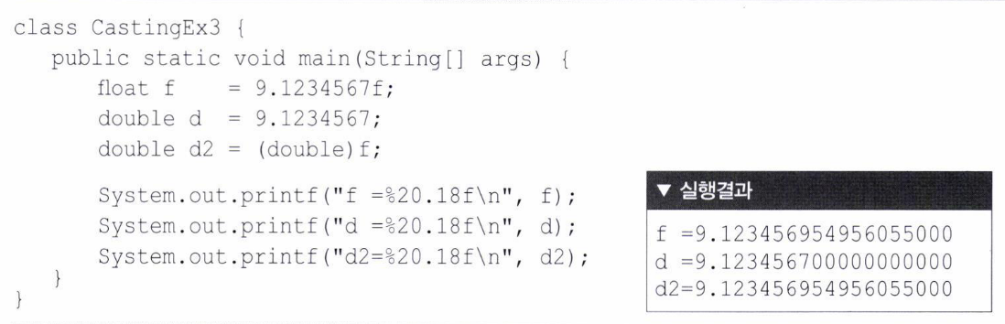

Slide 13
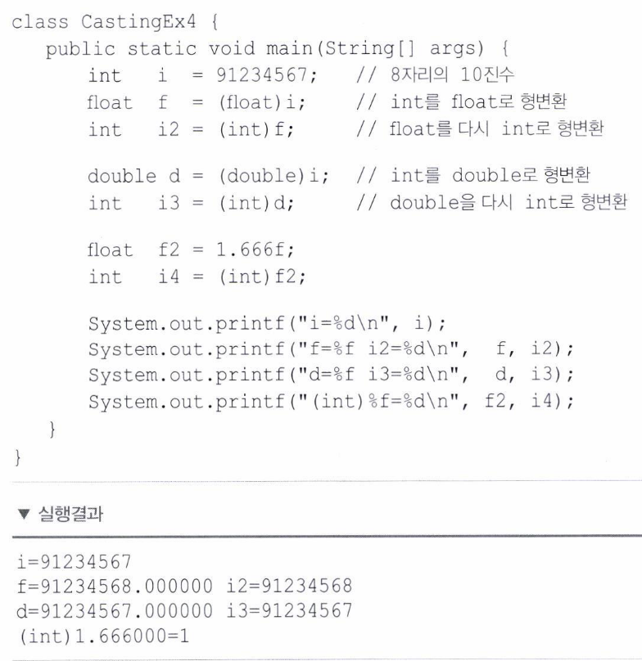

Slide 14
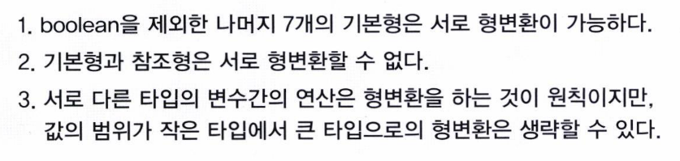


Slide 15

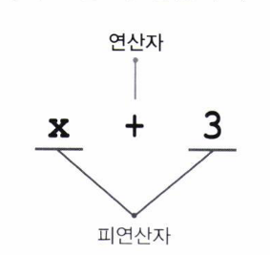
4 Data Type & Operator 4.2 Operator

Slide 16
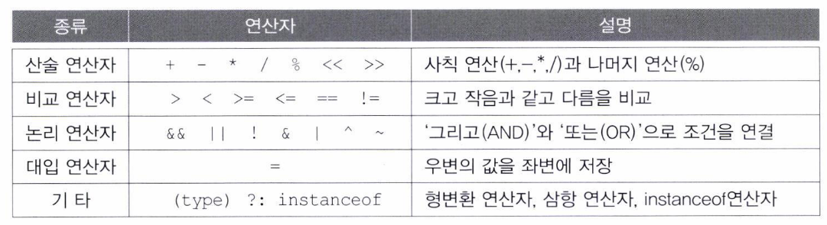

Slide 17

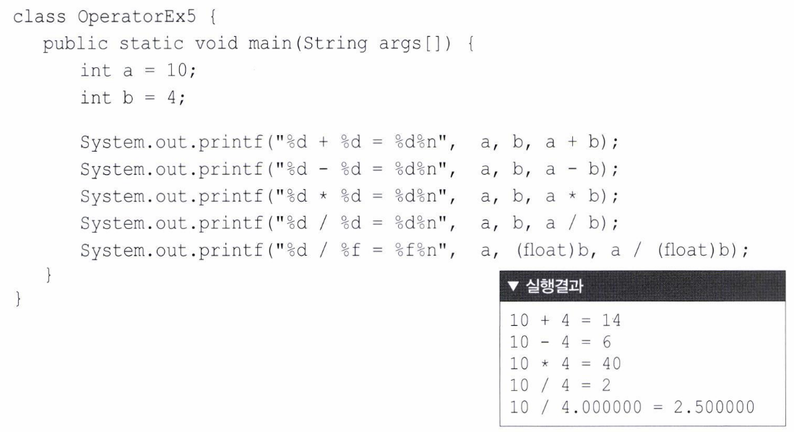

Slide 18

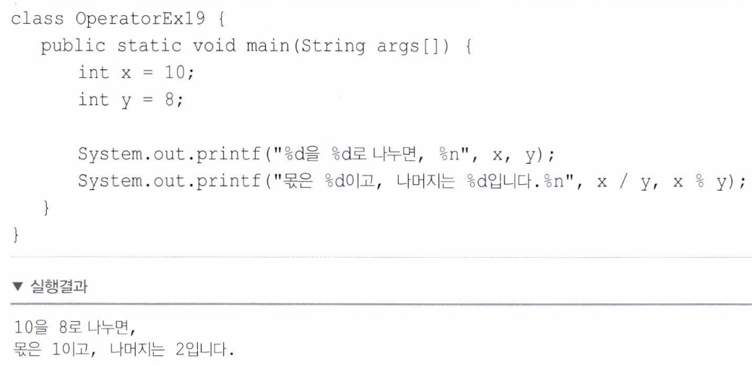

Slide 19

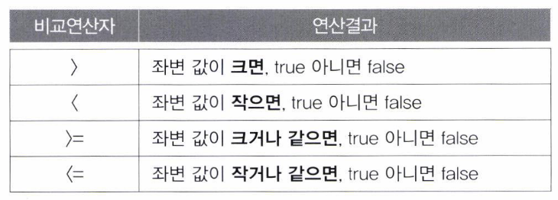
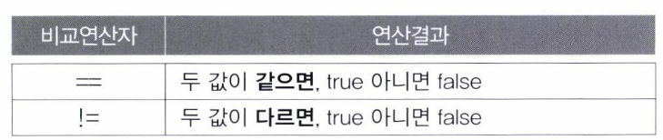

Slide 20
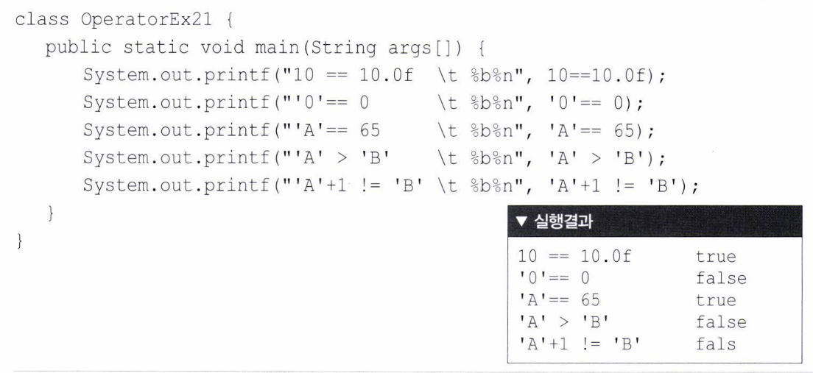

Slide 21
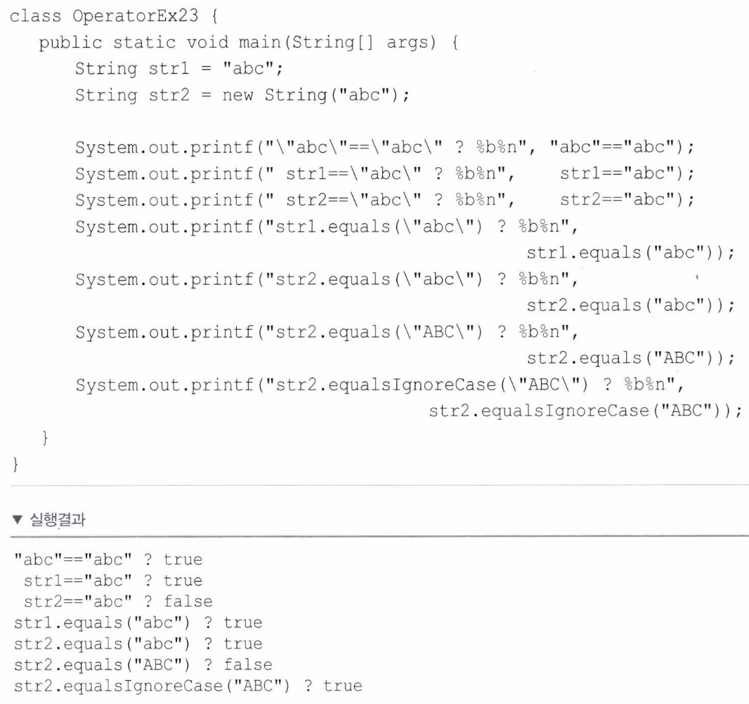

Slide 22

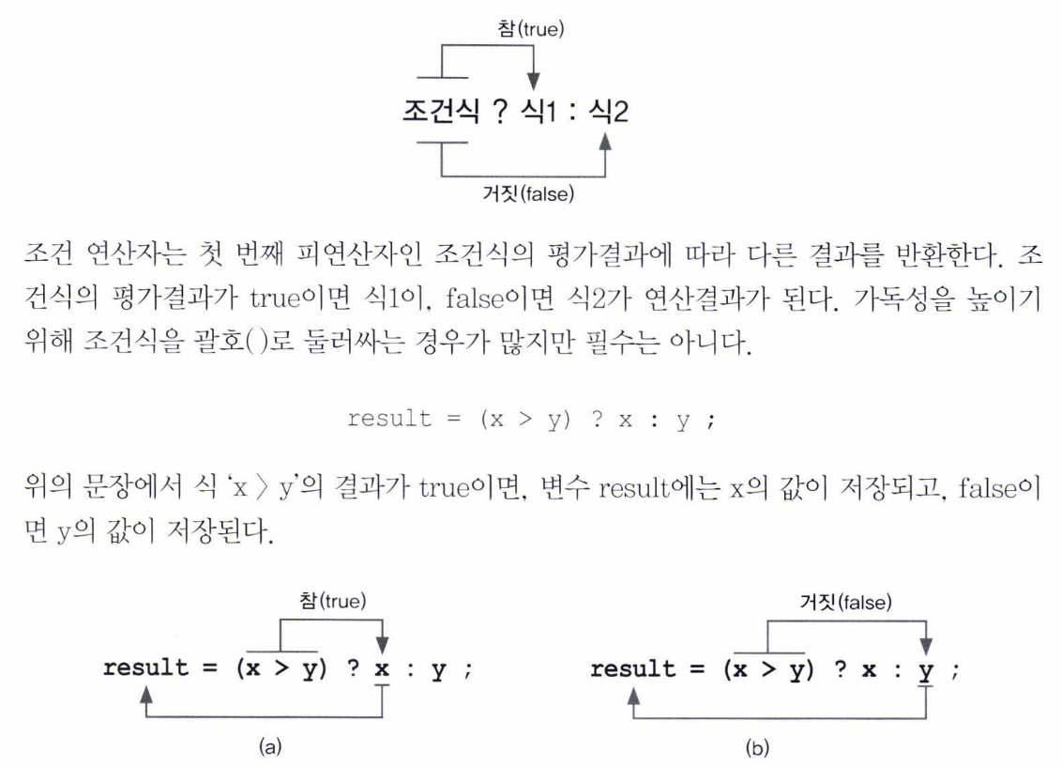

Slide 23
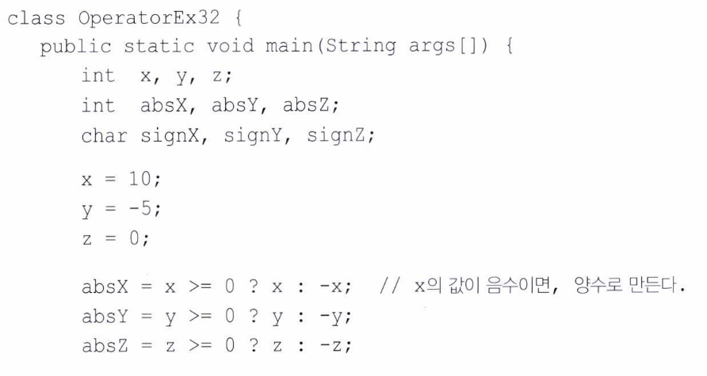
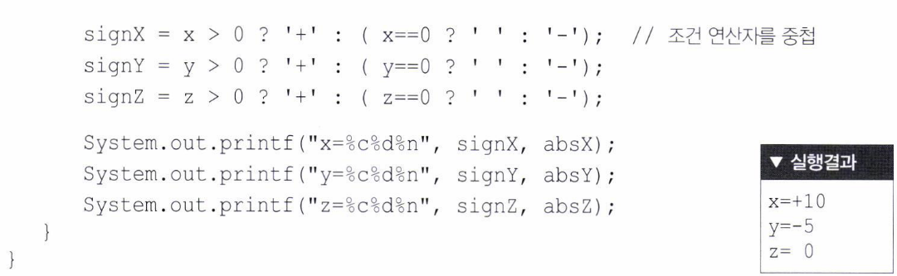

Slide 24
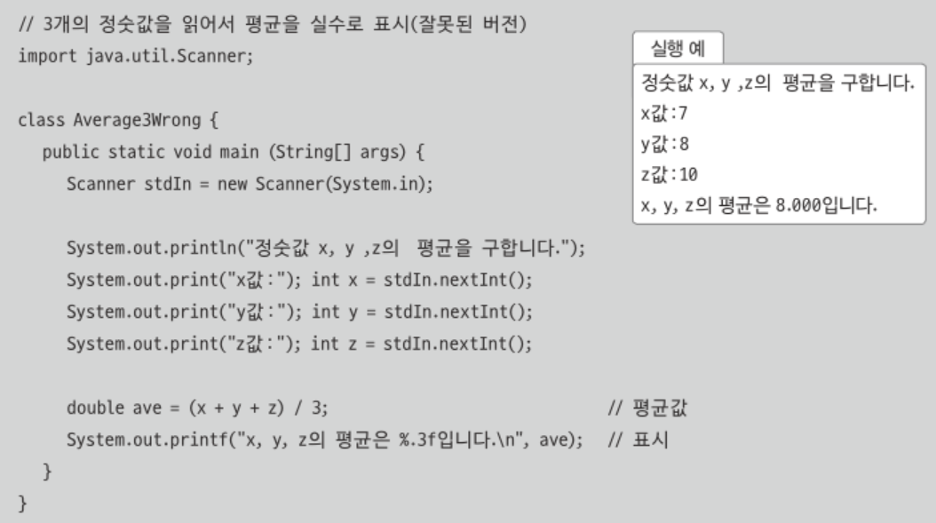
4 Data Type & Operator 4.3 Exam

Slide 25
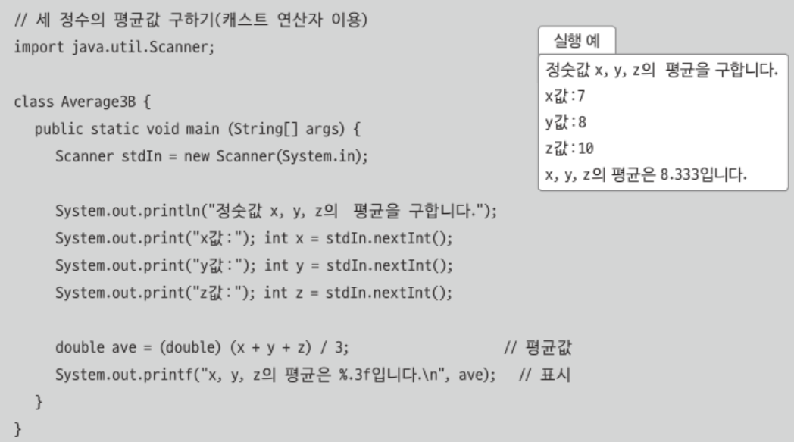

Slide 26
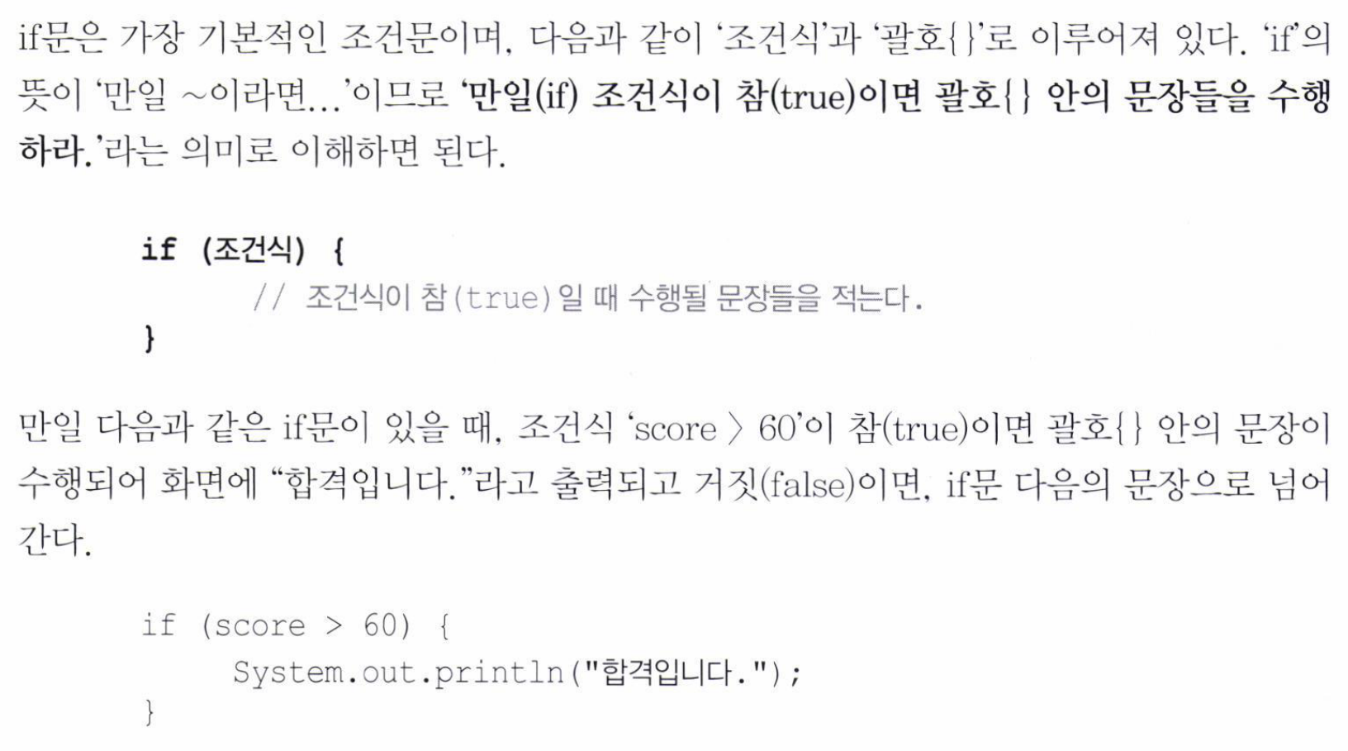
5 Control Statement 5.1 If

Slide 27
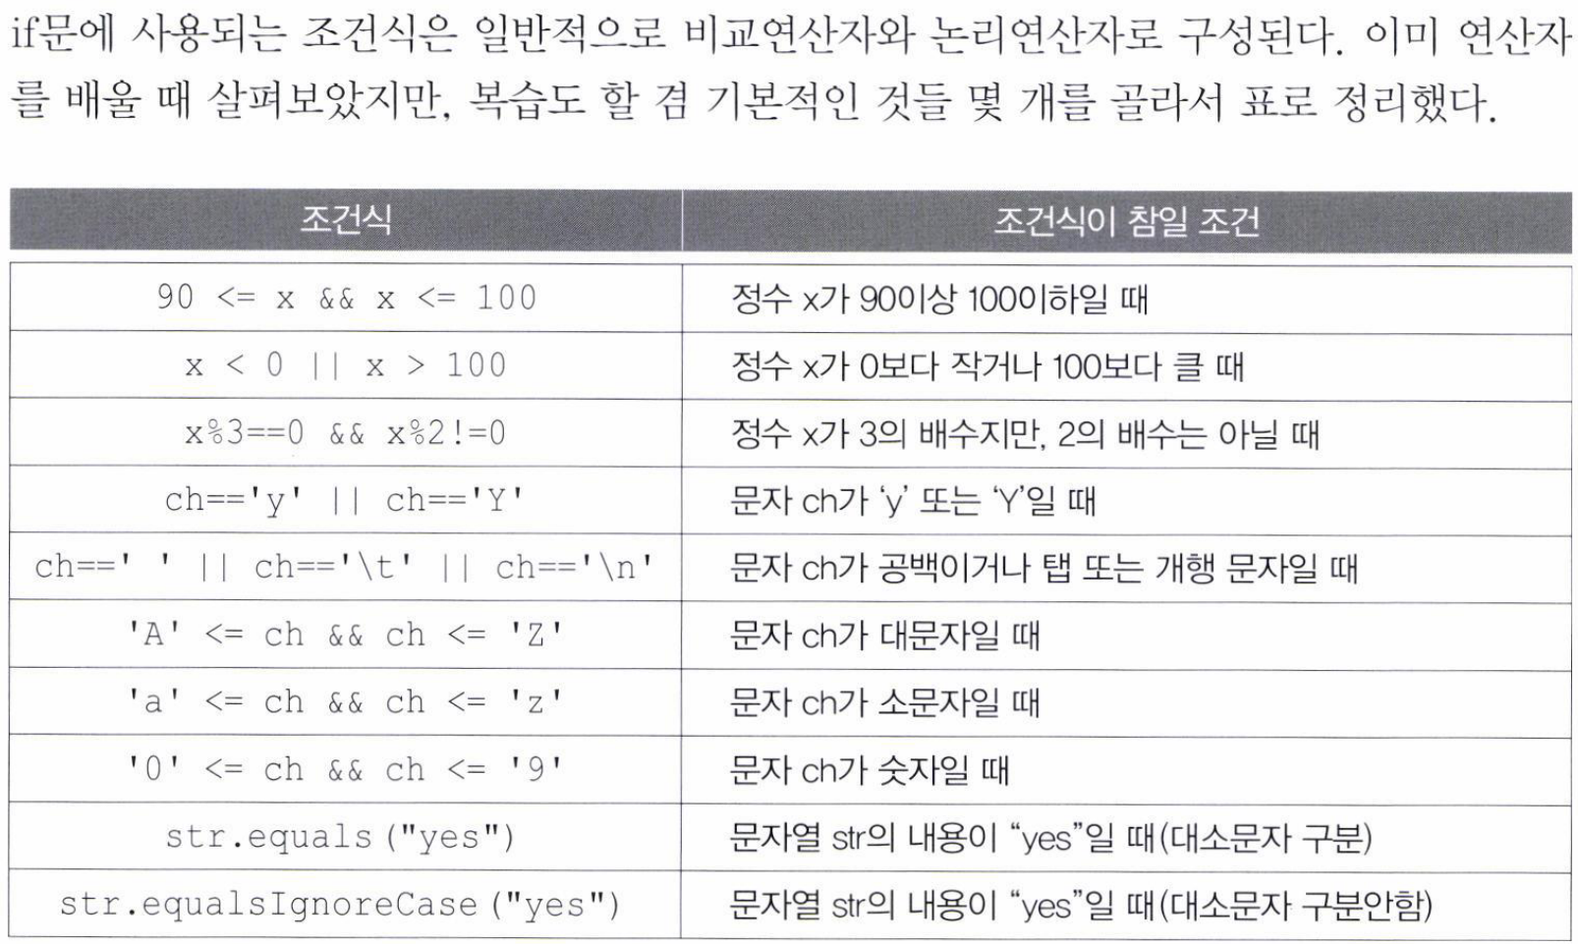

Slide 28
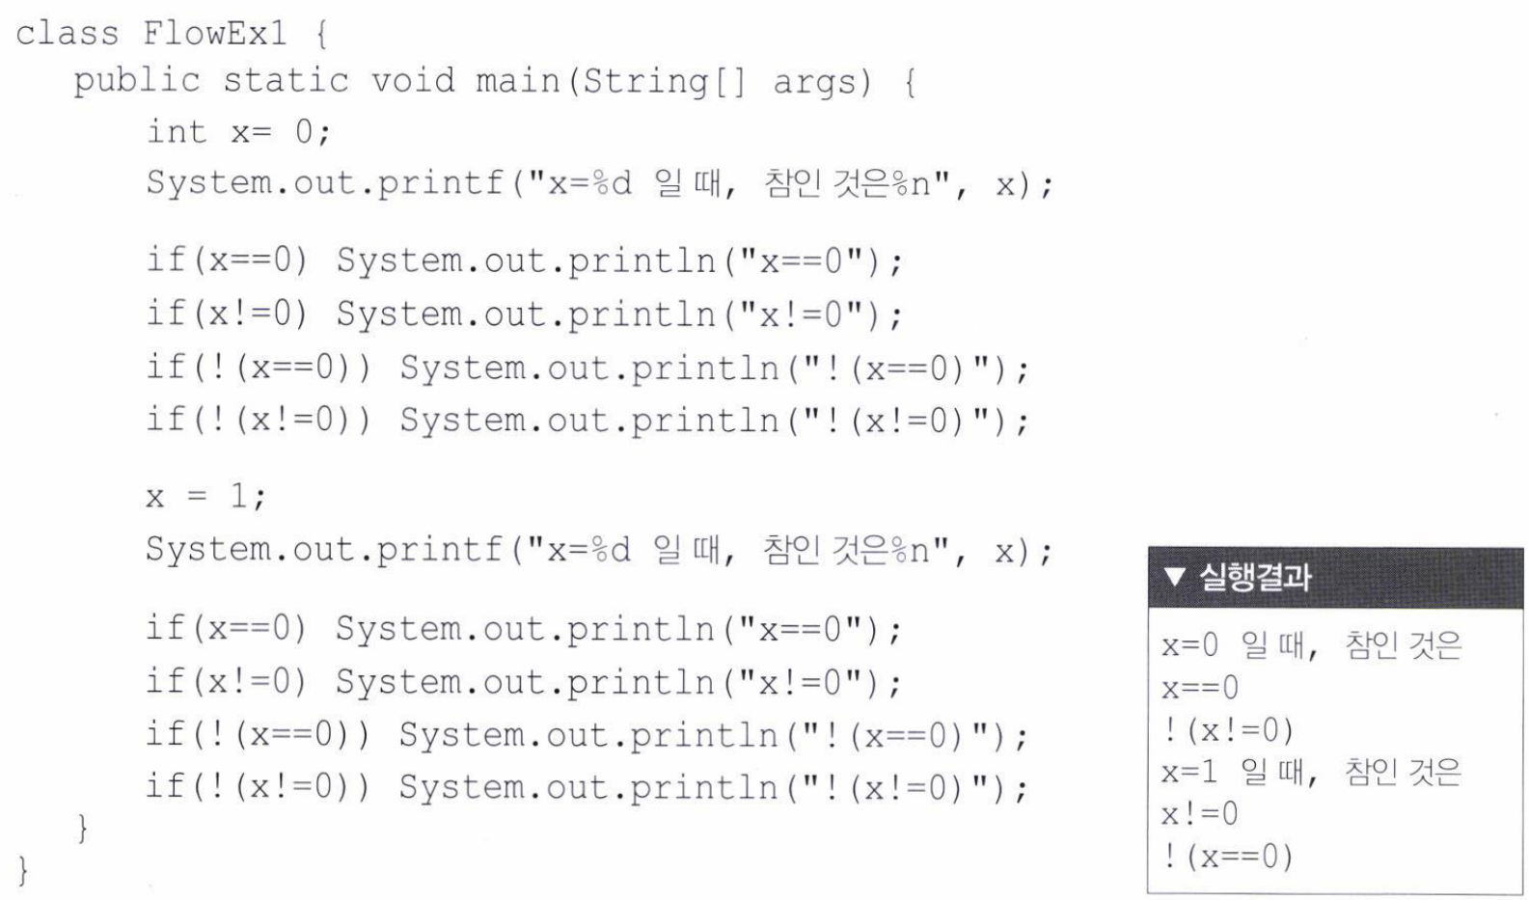

Slide 29
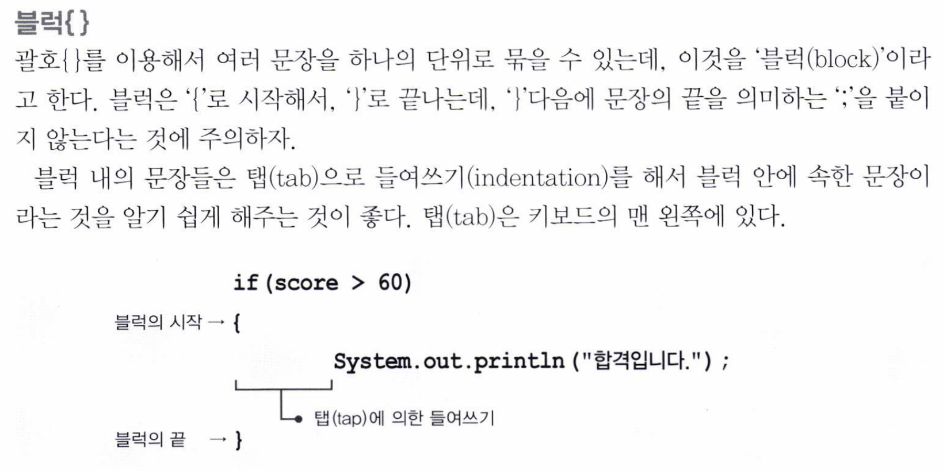

Slide 30
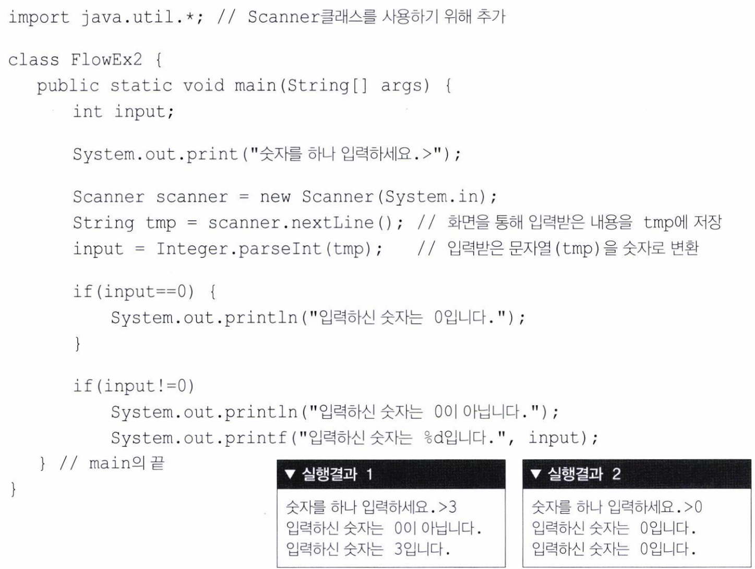

Slide 31
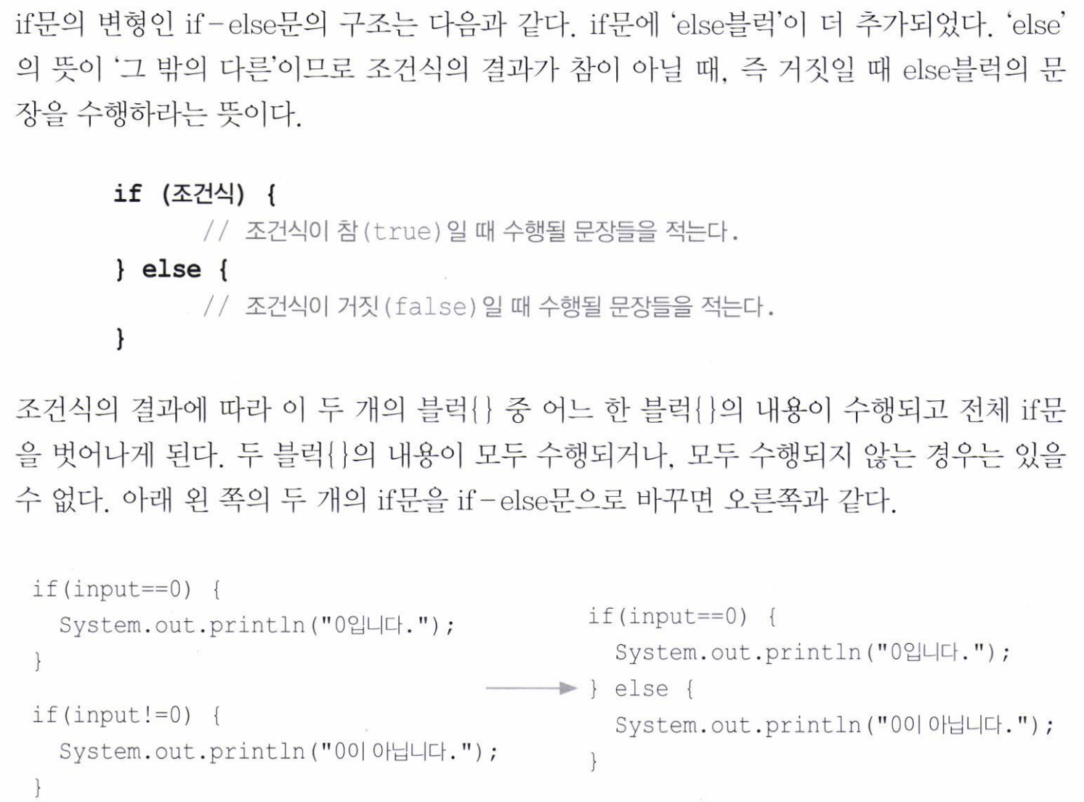

Slide 32
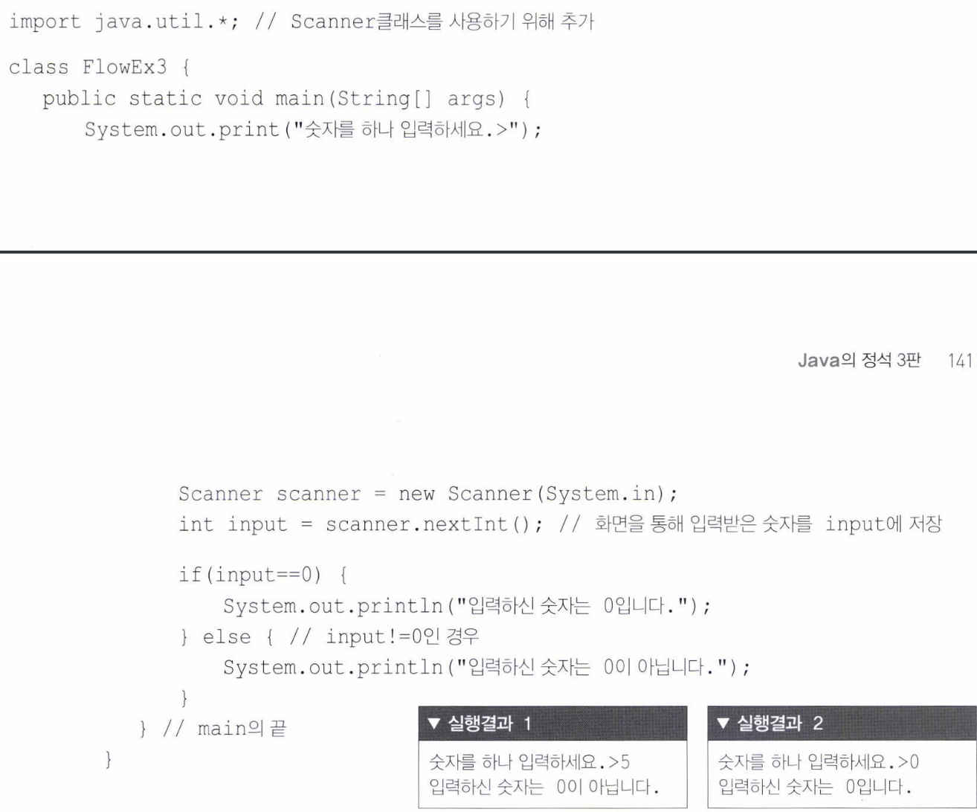

Slide 33
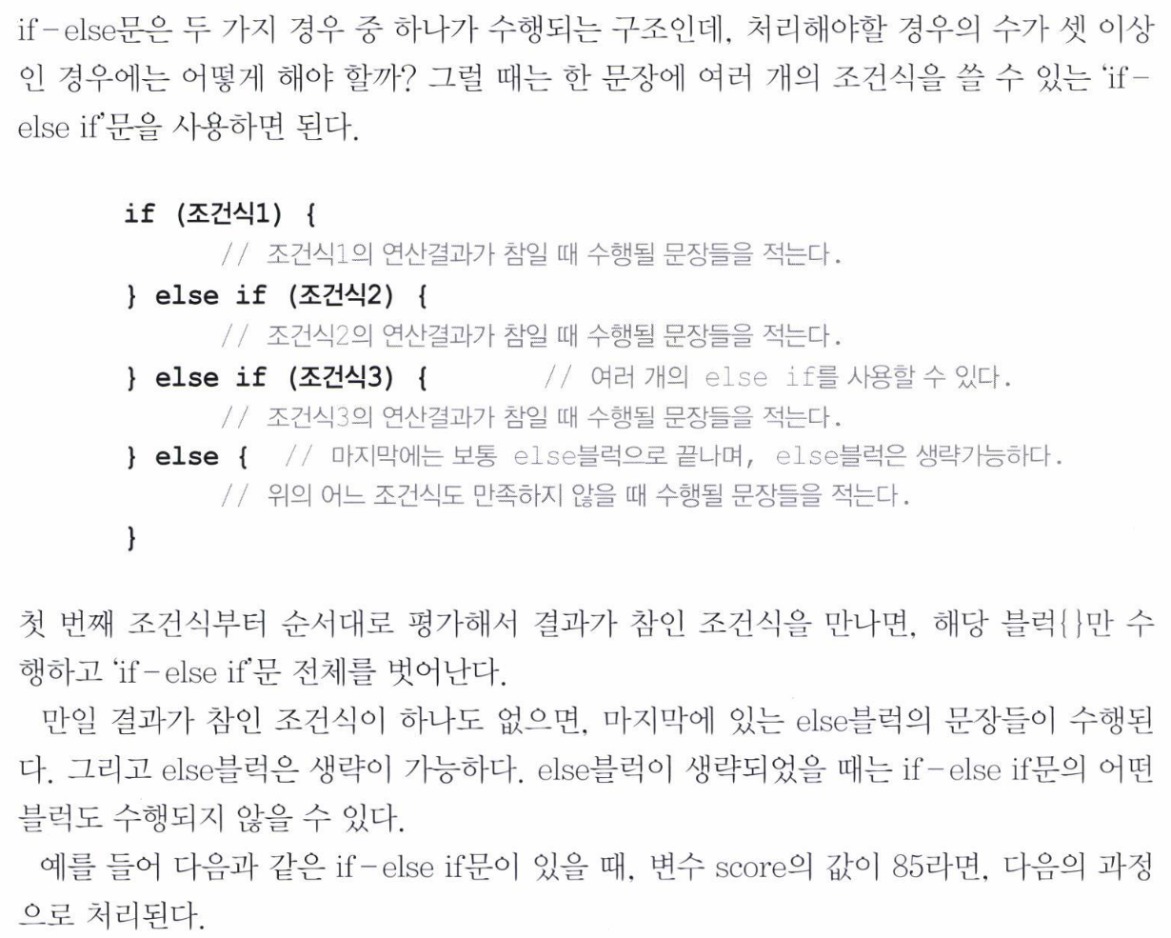
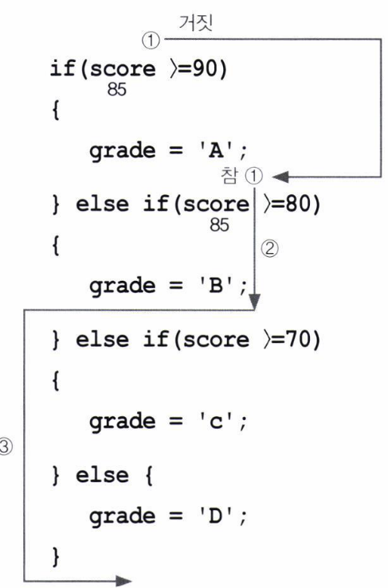

Slide 34
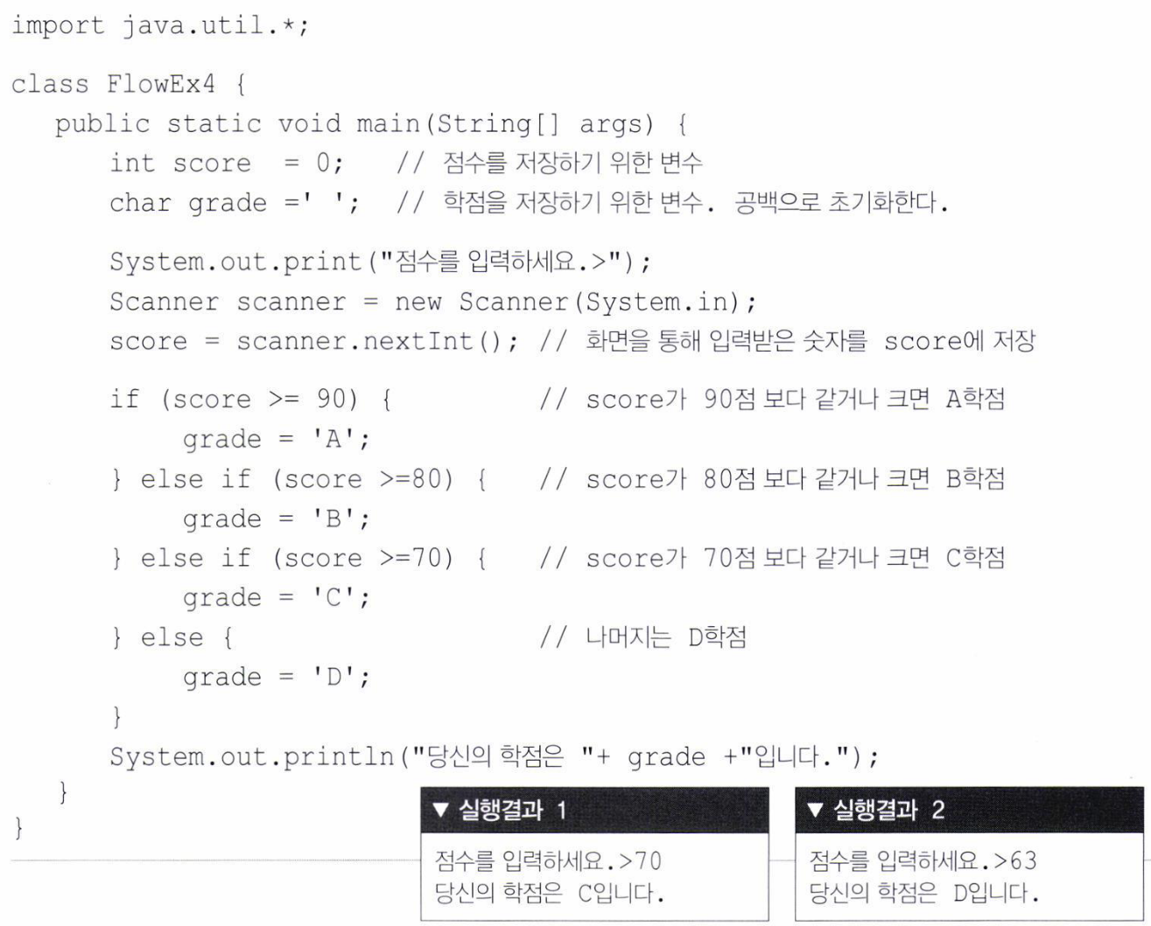

Slide 35
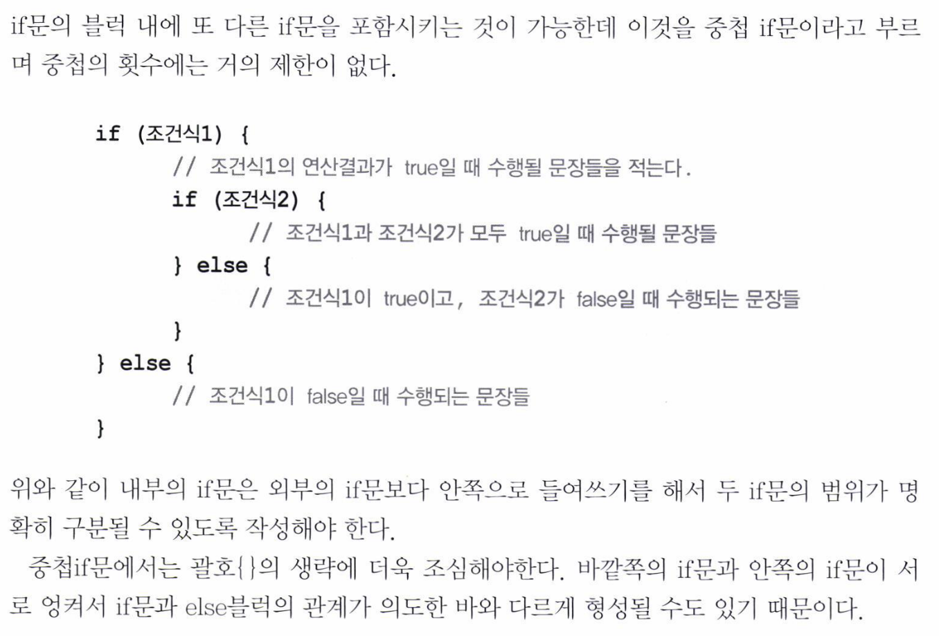

Slide 36
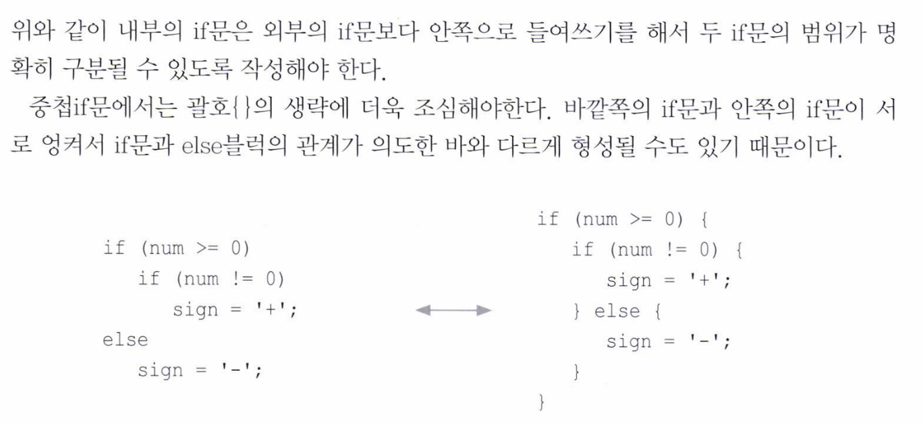

Slide 37
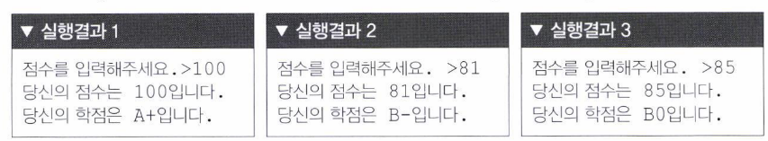
90 91 92 93 A-
94 95 96 A0
97 98 99 100 A+

Slide 38
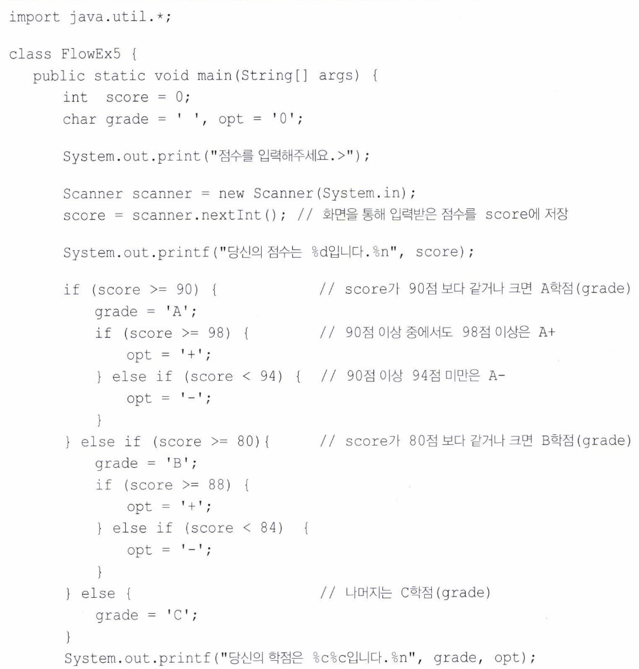

Slide 40
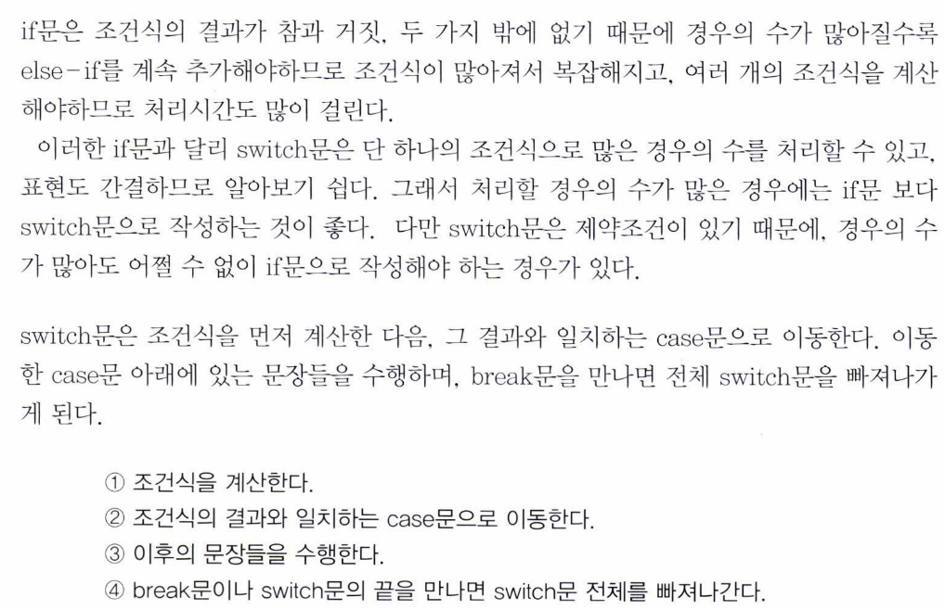

Slide 41
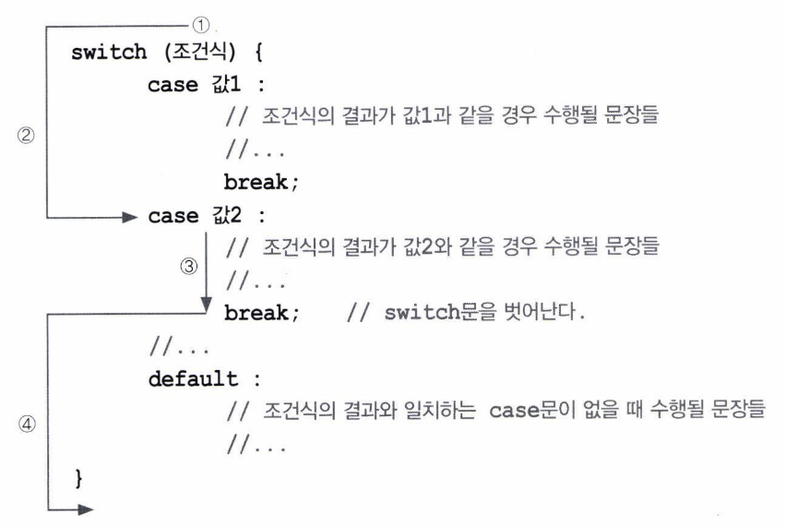

Slide 42
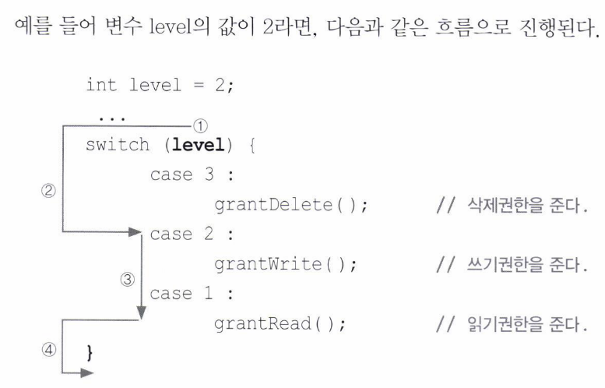

Slide 43
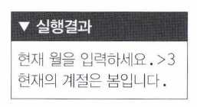

Slide 44
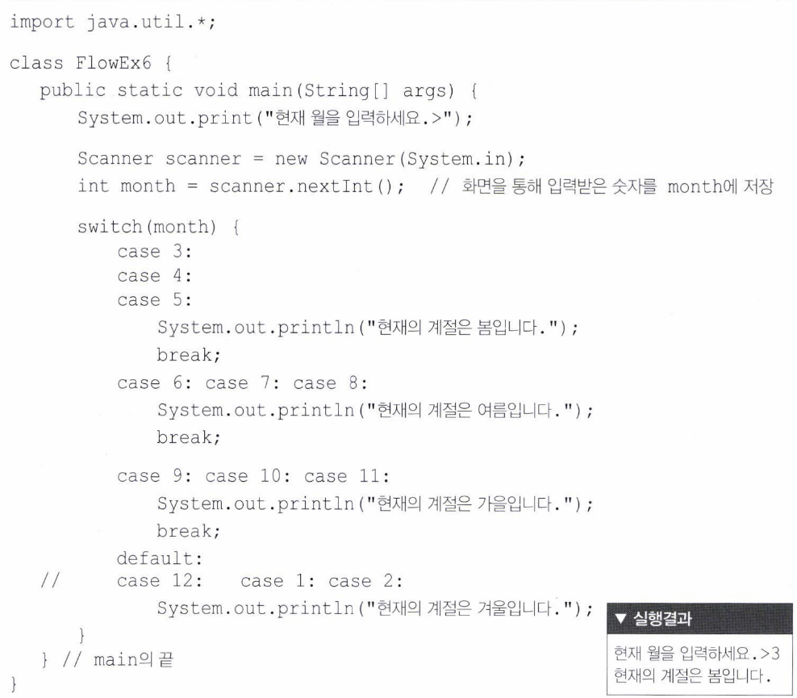

Slide 45
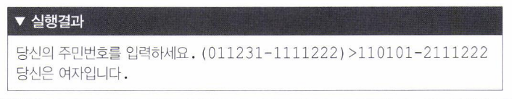
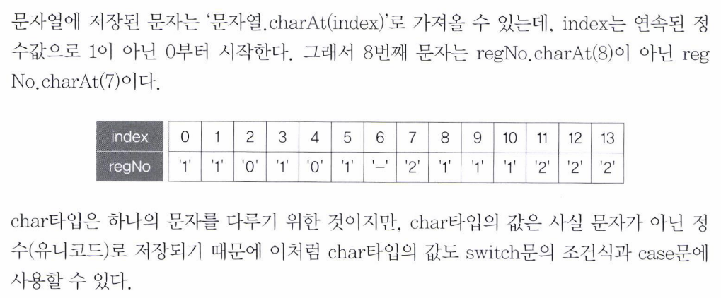

Slide 46
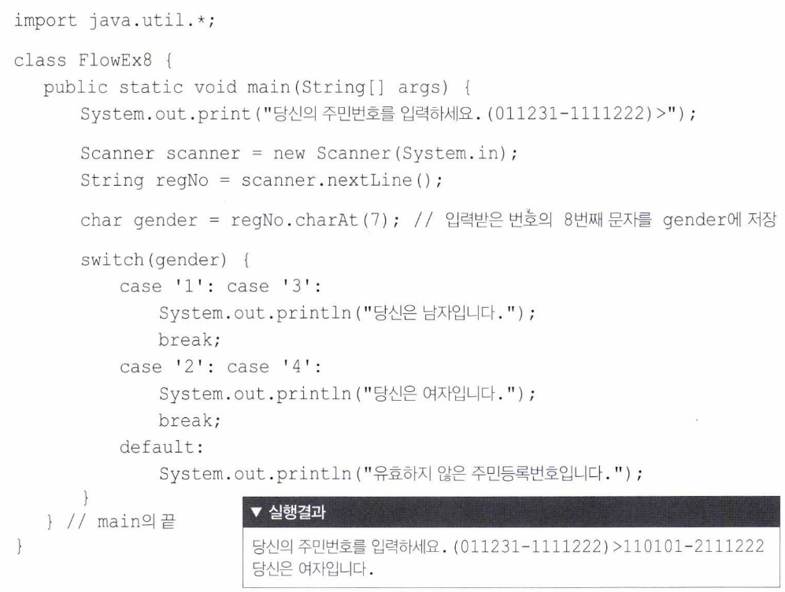

Slide 47
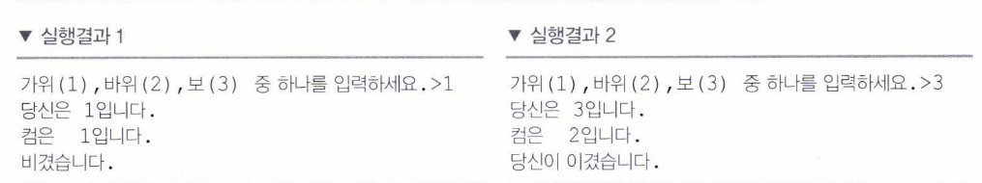
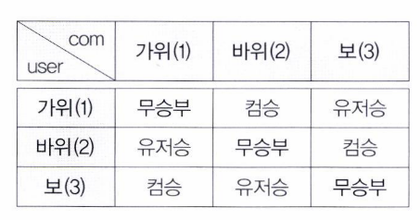
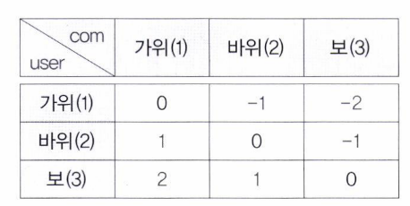

Slide 48


Slide 49


Slide 50




Slide 51



Slide 52


Slide 53


